Slide 1

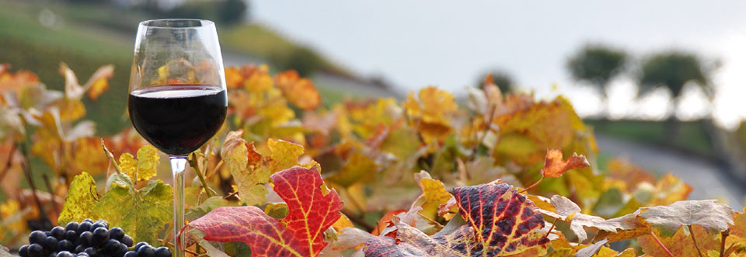
PREDICTION OF QUALITY OF WINE PROJECT BY -VALENCIA dIAS

Slide 2
AGENDA
INTRODUCTION
OBJECTIVE
DATASET DESCRIPTION
DATA CLEANING
EXPLORATORY DATA ANALYSIS
TECHNIQUE USED
IMPLEMENTATION
RESULTS
EVALUATIONS
CONCLUSION
CITATIONS

Slide 3
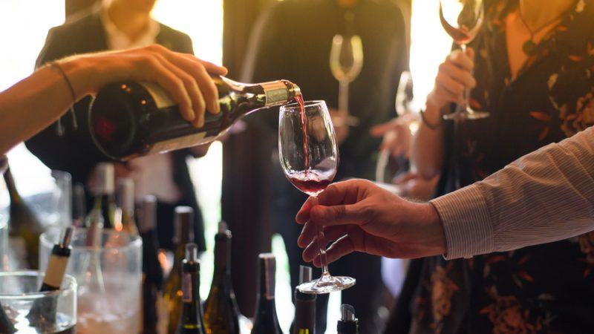
INTRODUCTION
In recent years, most of the industries promoting their products based on the quality certification they received on the products.
The traditional way of assessing the product quality is time consuming.
Although most of the chemicals are same for different type of wine based on the chemical tests, the quantity of each chemicals have different level of concentration for different type of wine.
These days it is important to classify different wine for quality assurance.

Slide 4
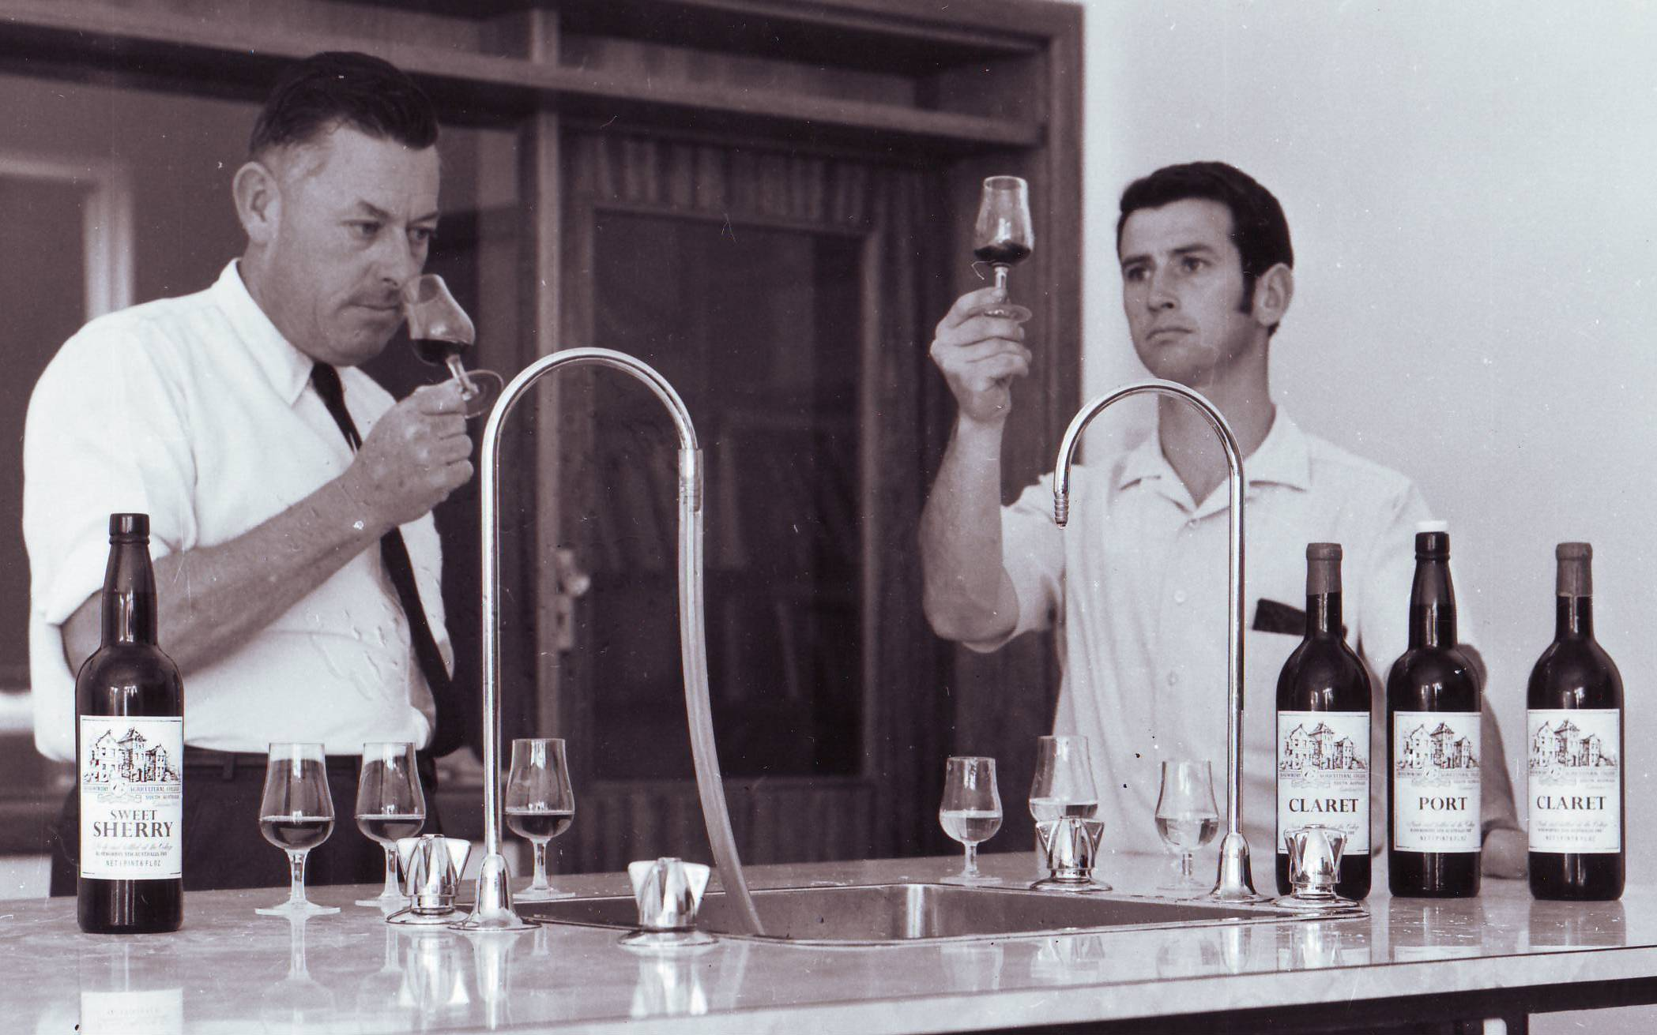
OBJECTIVE
The purpose of this project is to predict human wine taste preferences that are based on easily available analytical tests at the certification step.
The model developed will be useful to support the oenologist wine tasting evaluations and improve wine production.
The implementation of the technique will help in target marketing by modelling consumer tastes from niche markets.

Slide 5
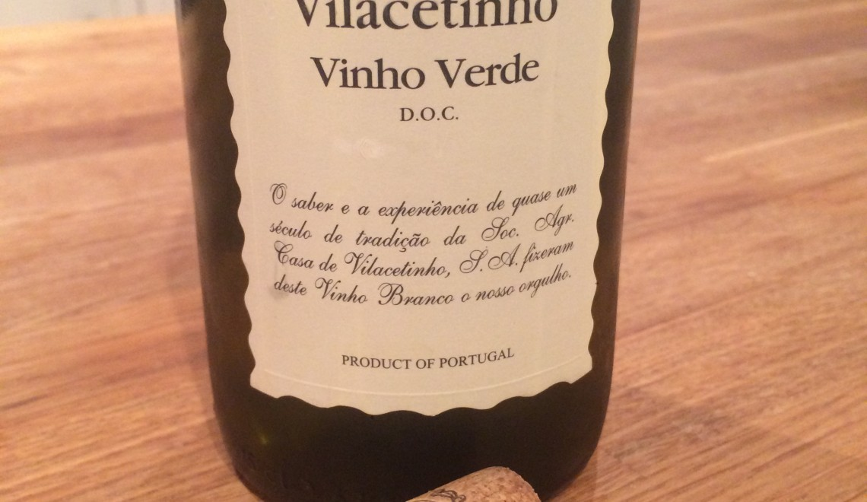
DATASET DESCRIPTION
The dataset is related to red variants of the Portuguese "Vinho Verde" wine.
Due to privacy and logistic issues, only physicochemical (inputs) and sensory (the output) variables are available (e.g. there is no data about grape types, wine brand, wine selling price, etc.)
The classes are ordered and not balanced (e.g. there are many more normal wines than excellent or poor ones).

Slide 6
Input variables (based on physicochemical tests):
1 -fixed acidity
2 -volatile acidity
3 -citric acid
4 -residual sugar
5 -chlorides
6 -free sulphur dioxide
7 -total sulphur dioxide
8 -density
9 -pH
10 -sulphates
11-alcohol
Output variable (based on sensory data):
12 - quality (score between 0 and 10)
Dataset link: https://archive.ics.uci.edu/ml/machine-learning-databases/wine-quality/

Slide 7
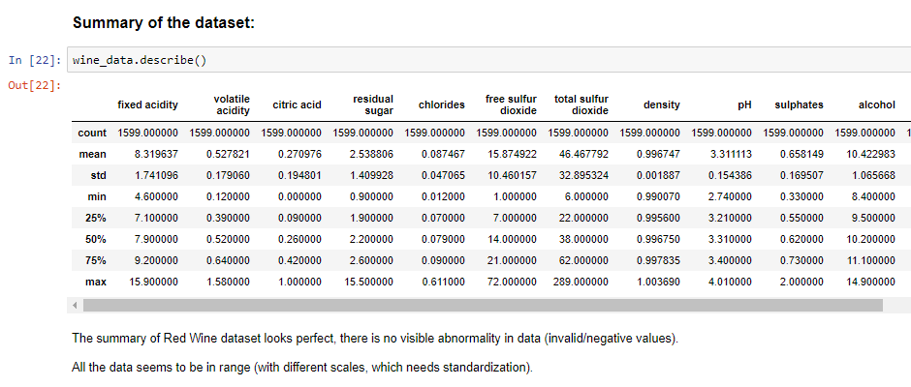
Descriptive Statistics:

Slide 8
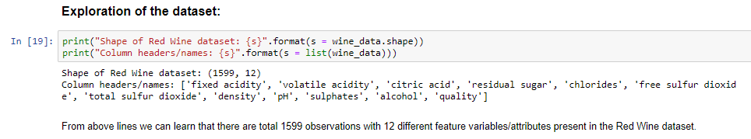
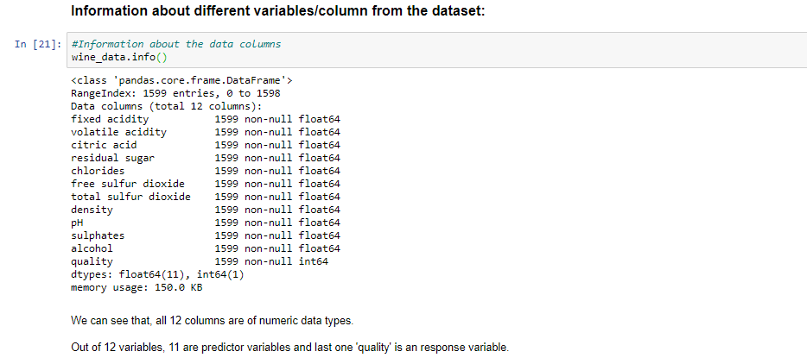

Slide 9
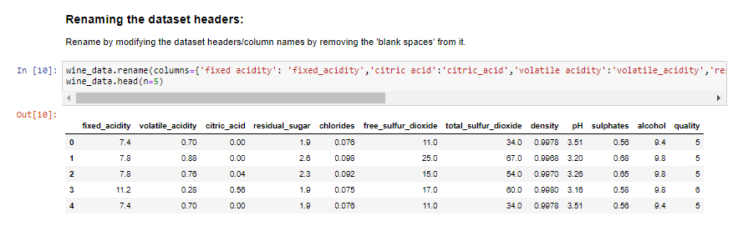
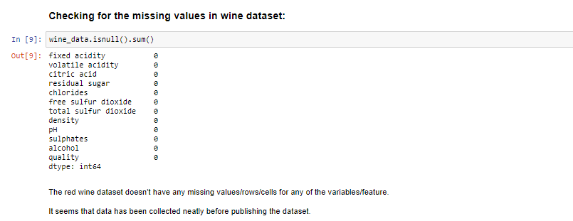
Data cleaninG
The red wine dataset doesn't have any missing values/rows/cells for any of the variables/feature.
It seems that data has been collected neatly before publishing the dataset

Slide 10
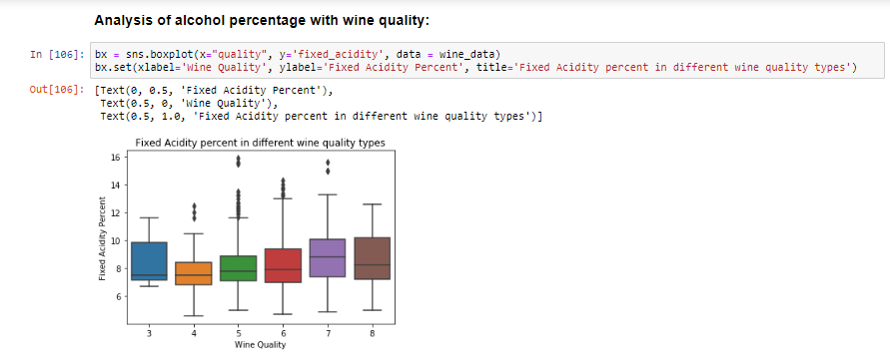
EXPLORATORY DATA ANALYSIS
Plotting boxplot to check for Outliers:
Target variable is Quality. So will plot boxplots for each column against target variable.
fixed acidity - 25% - 7.1 and 50% - 7.9. Not much of a variance. Could explain the huge number of outliers

Slide 11
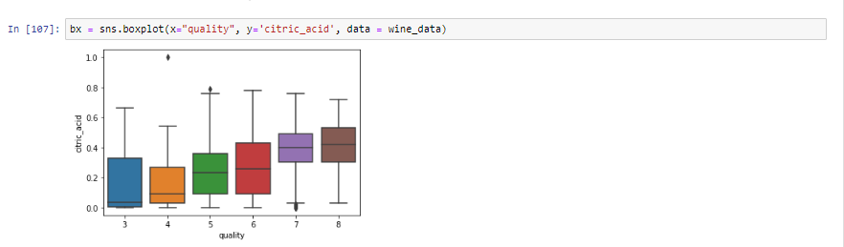
citric acid - seems to be somewhat uniformly distributed

Slide 12
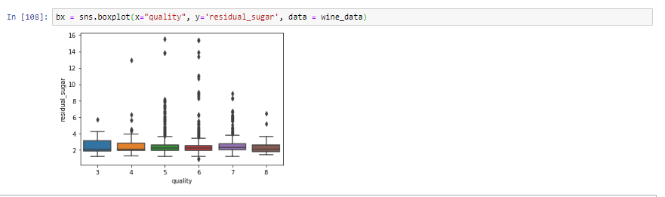
residual sugar - min - 0.9, max – 15 -Way too much difference. Could explain the outliers.

Slide 13
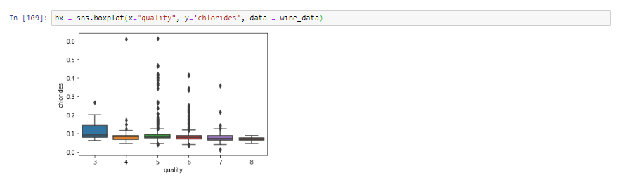
chlorides - same as residual sugar. Min - 0.012, max - 0.611

Slide 14
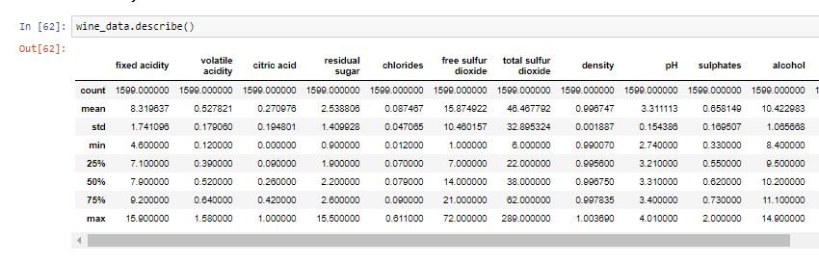

Slide 15
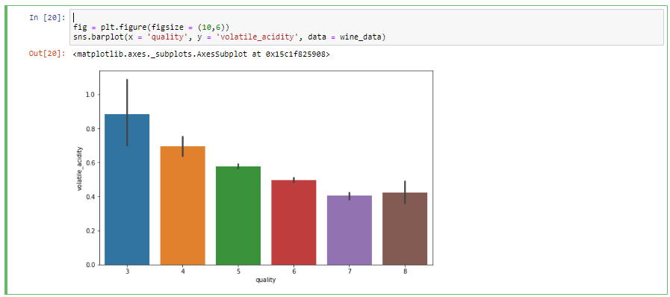
Plotting to know how the data columns are distributed in the dataset:
Here we see that its quite a downing trend in the volatile acidity as we go higher the quality.

Slide 16
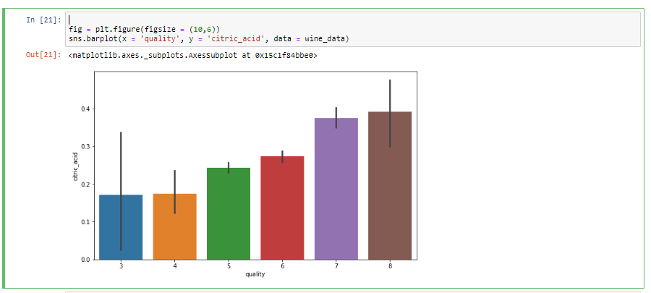
Composition of citric acid go higher as we go higher in the quality of the wine

Slide 17
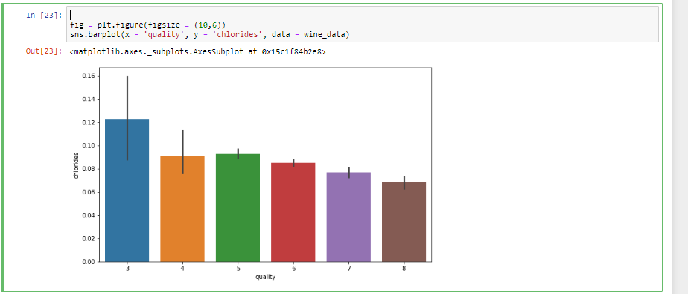
Composition of chloride also go down as we go higher in the quality of the wine

Slide 18
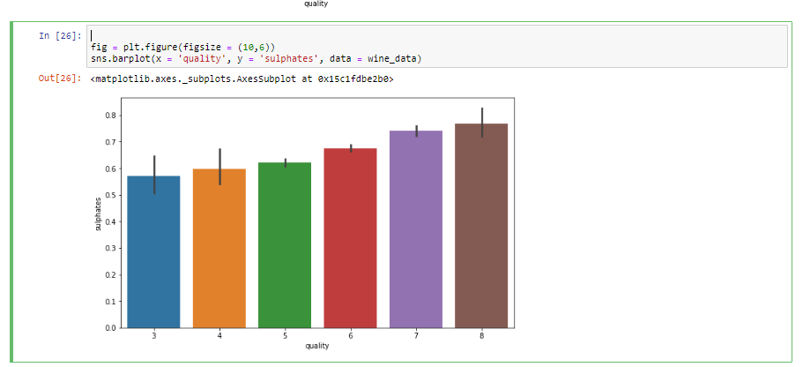
Sulphates level goes higher with the quality of wine

Slide 19
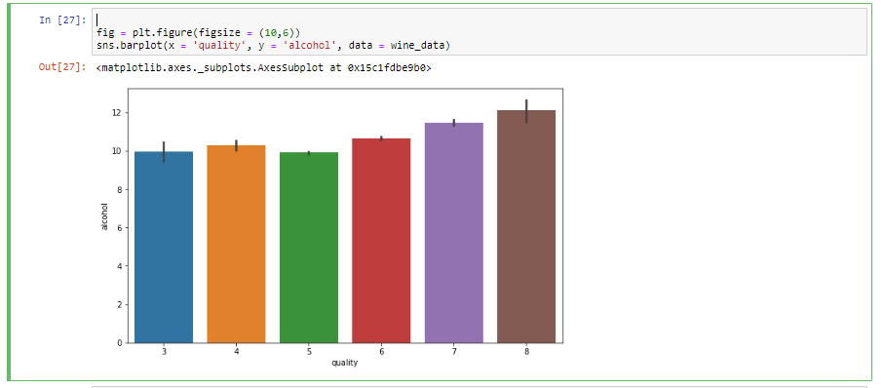
Alcohol level also goes higher as the quality of wine increases

Slide 20
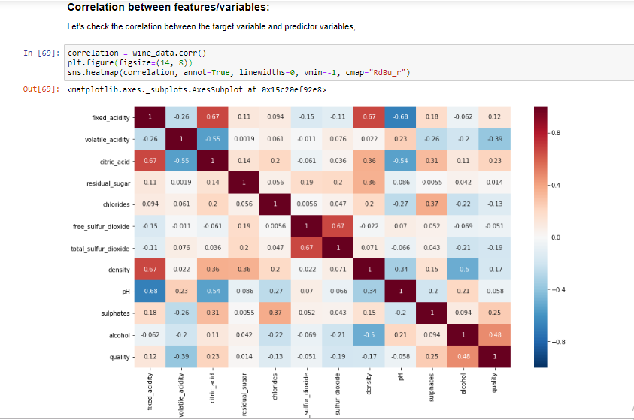
PLOTING the HEATMAP :
We can observe that, the 'alcohol, sulphates, citric_acid & fixed_acidity' have maximum correlation with response variable 'quality'.
This means that, they need to be further analyzed for detailed pattern and correlation exploration.

Slide 21
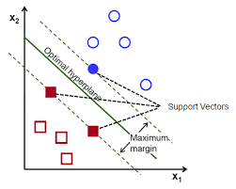
Technique used:
CLASSIFICATION TECHNIQUE:SUPPORT VECTOR MACHINE
“A Support Vector Machine (SVM) is a discriminative classifier formally defined by a separating hyperplane”.
Working of Support Vector Machine:
SVM or Support Vector Machine is a linear model for classification and regression problems. It can solve linear and non-linear problems and work well for many practical problems.
The idea of SVM is simple: The algorithm creates a line or a hyperplane which separates the data into classes.
At first approximation what SVMs do is to find a separating line(or hyperplane) between data of two classes.
SVM is an algorithm that takes the data as an input and outputs a line that separates those classes if possible.
According to the SVM algorithm we find the points closest to the line from both the classes. These points are called support vectors. Now, we compute the distance between the line and the support vectors. This distance is called the margin. Our goal is to maximize the margin. The hyperplane for which the margin is maximum is the optimal hyperplane.

Slide 22
Tuning parameters: Kernel, Regularization, Gamma and Margin.
Kernel-The learning of the hyperplane in linear SVM is done by transforming the problem using some linear algebra. This is where the kernel plays role.
Regularization-The Regularization parameter (often termed as C parameter in python’s sklearn library) tells the SVM optimization how much you want to avoid misclassifying each training example.
Gamma-The gamma parameter defines how far the influence of a single training example reaches, with low values meaning ‘far’ and high values meaning ‘CLOSE’.

Slide 23
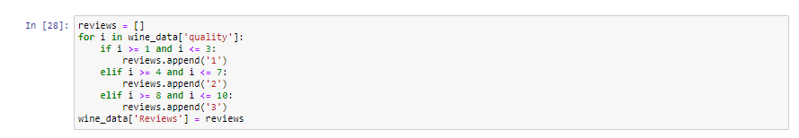
IMPLEMENTATION
Preprocessing of data:
Preprocessing of the data is required so that the it is ready for different machine learning algorithms to be applied on it.

Slide 24
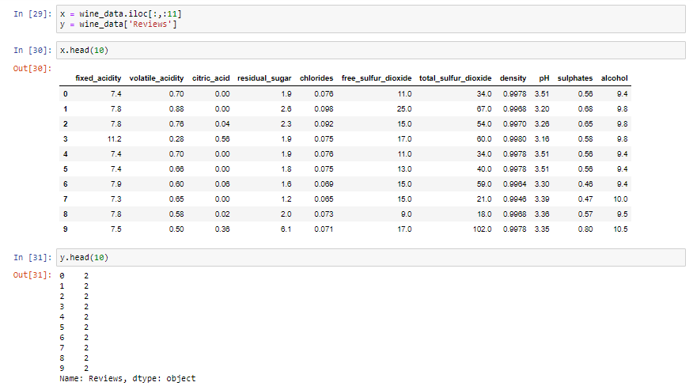

Slide 25
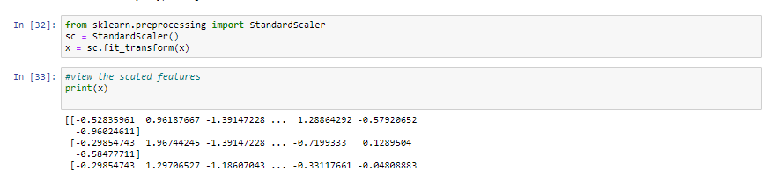
Scaling the Data:

Slide 26
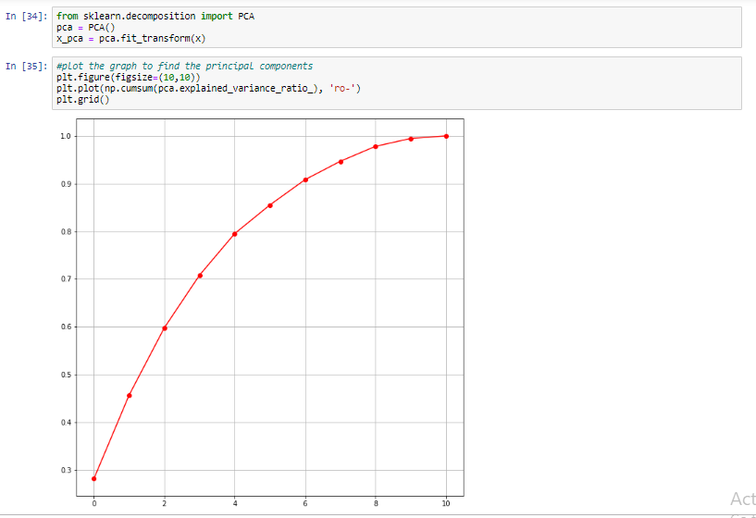
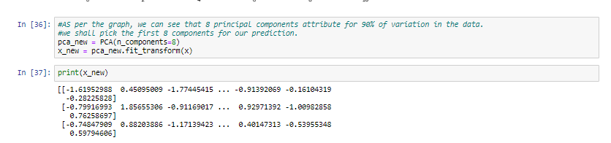
AS per the graph, we can see that 8 principal components attribute for 90% of variation in the data. We shall pick the first 8 components for our prediction.

Slide 27
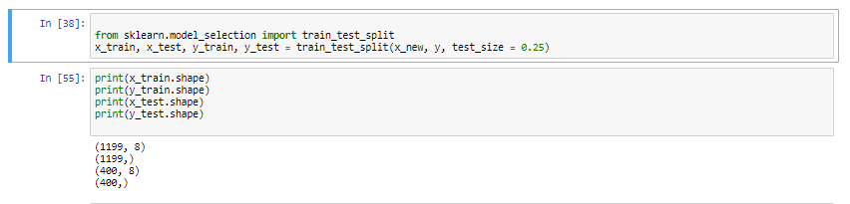
Dividing the dataset into training and test sets:

Slide 28
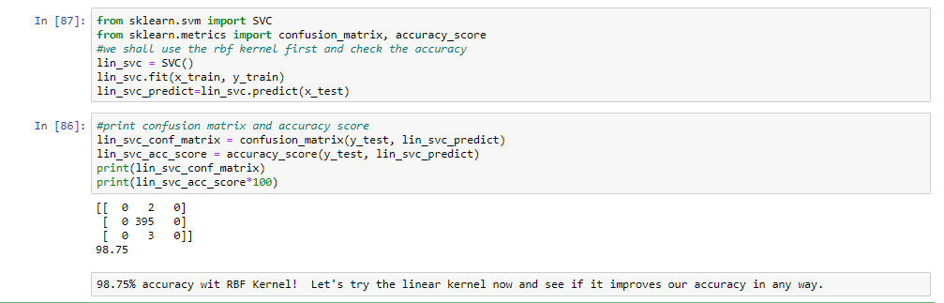
RESULTS
Printing the confusion matrix and accuracy score obtained from SVC using the “rbf” kernel.

Slide 29
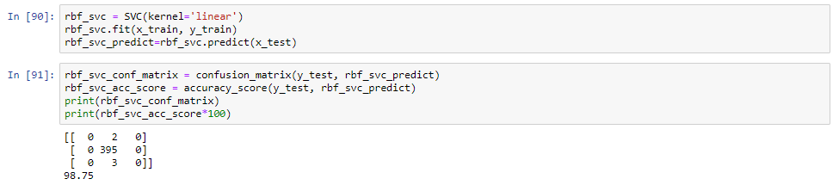
Checking the SVC model with “linear” Kernel.

Slide 30
Evaluation:
Performance of the model:
The model developed performed very well with an accuracy of 98.75%

Slide 31
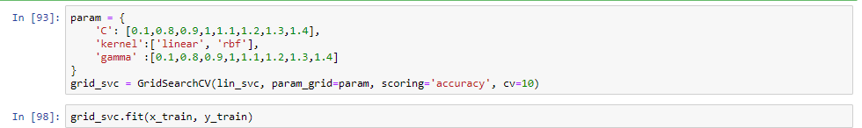
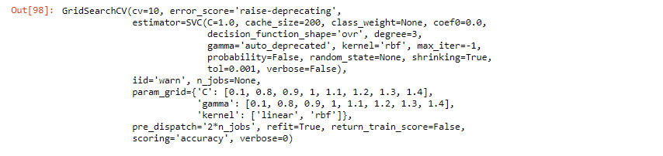
GRID SEARCHCV:
The traditional way of performing hyperparameter optimization has been grid search, or a parameter sweep, which is simply an exhaustive searching through a manually specified subset of the hyperparameter space of a learning algorithm.
A grid search algorithm must be guided by some performance metric.

Slide 32
Finding the Best Parameters:

Slide 33
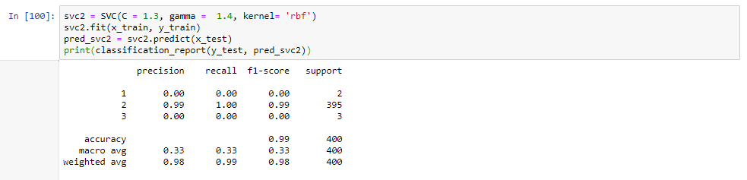
Running the SVC Model with best parameters:

Slide 34
CONCLUSION:
The model developed will be useful to support the oenologist wine tasting evaluations and improve wine production.
The implementation of the technique will help in target marketing by modelling consumer tastes from niche markets.
The model developed performed very well with an accuracy of 98.75%
Accuracy of 99% HAS BEEN achieved by feeding the best parameters that are obtained by the Grid SearchCV.

Slide 35
CITATIONS:
https://medium.com/machine-learning-101/chapter-2-svm-support-vector-machine-theory-f0812effc72
https://towardsdatascience.com/https-medium-com-pupalerushikesh-svm-f4b42800e989
https://ieeexplore.ieee.org/document/8702017
https://stackabuse.com/cross-validation-and-grid-search-for-model-selection-in-python/

Slide 36
THANK YOU!!

